Slide 1
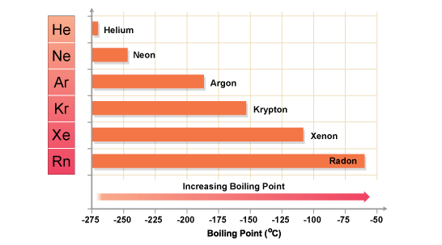
Q-I.1.The boiling point of the inert gases are as follows: He – 4 K , Ne –10 K, Ar – 100 K, Kr –170 K and Xe –220K. Rationalize the trend observed.
CH-105 INORGANIC TUTORIAL -I
Topic-I
Ans:
He < Ne < Ar < Kr < Xe
As moving down the group the size increases and the atom can be polarized easily, hence induced dipole-induced dipole interactions are stronger in Xe compared to He. Therefore, the boiling point increases down the group. The number of electrons that can contribute to the induced dipoles is also increasing as we go from He to Xe.

Slide 2
Q-I.2.Between the two reactions listed below, predict the following (i) in which direction the reaction equilibrium lies (ii) qualitatively predict which reaction is expected to be faster using the following absolute η values.
CH-105 INORGANIC TUTORIAL -I
Topic-I
HCl + LiH ⇋ LiCl + H₂
8.0 4.08 4.75 8.7
HOF + LiH ⇋ LiF + H₂O
7.82 4.08 5.87 9.5
Ans.
η for first reaction = <η>_{LHS} = 6.04 and <η>_{RHS} = 6.72.
for second reaction <η>_{LHS} = 5.95 and <η>_{RHS} = 7.68.
Thus for both the reaction, equillibrium lies on right side. However, the difference between the <η>_{LHS} and <η>_{RHS} for the first reaction is 0.68, while for the second reaction is 1.73. Qualitatively, this suggests that the second reaction is expected to be faster.

Slide 3
Q-I.3. Predict the relative solubility trend in water for the following two sets of molecules. (a) NaF, NaCl, NaBr, NaI (b) CuF, CuCl, CuBr and CuI. Briefly rationalize your answer.
CH-105 INORGANIC TUTORIAL -I
Topic-I
Ans.
The solubility of set a) will increase in the order of
NaF < NaCl < NaBr < NaI (here Na⁺ and I⁻ are hard base and soft acid respactively)
For Set b) solubility will decrease in the order of
CuF > CuCl > CuBr > CuI. (here I⁻ and Cu⁺ are soft acid and soft base respactively)
Soft acid-soft base combination is more covalent and less soluble in polar solvents like water.

Slide 4
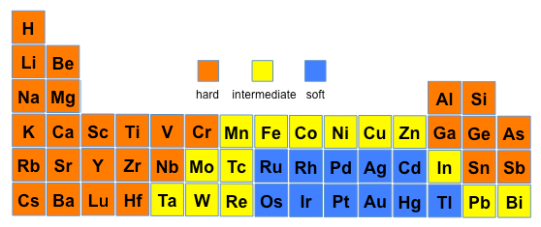
CH-105 INORGANIC TUTORIAL -I
Topic-I

Slide 5
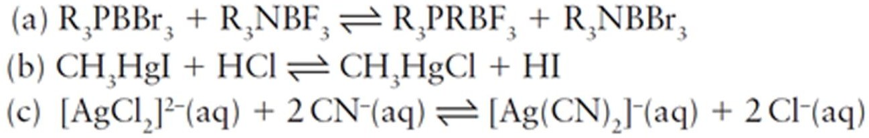
Q-I.4. Using hard-soft concepts, which of the following reactions are predicted to have an equilibrium constant greater than 1? Unless otherwise stated, assume gas-phase or hydrocarbon solution and 25°C.
CH-105 INORGANIC TUTORIAL -I
Topic-I
Ans: For reaction (a)
R₃PBBr₃ + R₃NBF₃ ⇋ R₃PBF₃ + R₃NBBr₃ ↙ ↘ Soft- Soft interaction Soft-Hard interaction R₃P > R₃N BBr₃ > BF₃ softer base softer lewis acid

Slide 6
For raction (b): CH₃HgI + HCl ⇋ CH₃HgCl + HI ↙ ↘ Soft- Soft interaction Soft-Hard interaction CH₃Hg⁺ > H⁺ I⁻ > Cl⁻ softer acid softer base
CH-105 INORGANIC TUTORIAL -I
Topic-I
For raction (c):
[AgCl₂]²⁻_{(aq)} + 2CN⁻_{(aq)} ⇋ [AgCN₂]²⁻_{(aq)} + 2Cl⁻ _{(aq)}
↙ ↘ Soft- Hard interaction Soft-Soft interaction Ag⁺ CN⁻ > Cl⁻ soft acid softer base

Slide 7
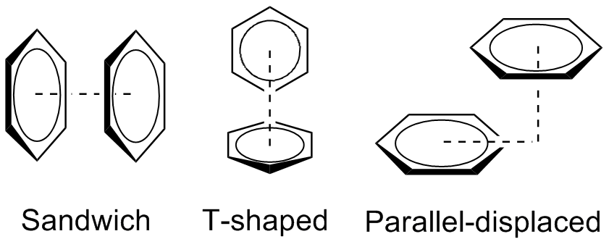
Q-I.5. Draw at least two possible interactions that can exist between 1,3,5- trinitrobenzene and benzene. Identify the most stable form.
CH-105 INORGANIC TUTORIAL -I
Topic-I
Ans:
Stability order:
A>B

Slide 8
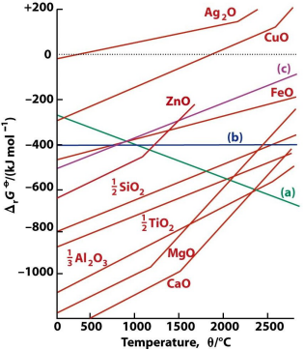
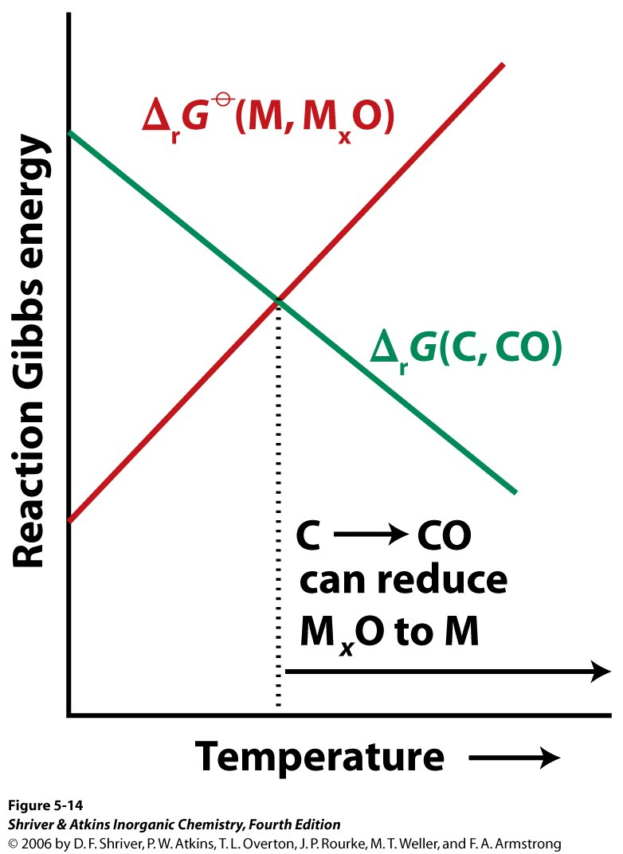
CH-105 INORGANIC TUTORIAL -I
Topic-II
Q-II.1. Why are the metals Al and Ti are not produced by pyrometallurgical extraction of Al₂O₃ and TiO₂? What will be a better method to produce such metals?
Ans:
Carbon can reduce any metal oxide provided that the temperature is sufficiently high. The plot of C (C→CO) in Ellingham Diagram will intersect all the metal -metal oxide curves because of the reverse slope of the C line. However, the use of C (coke) becomes impracticable for the metal oxides towards the bottom of the Ellingham Diagram, e.g., CaO, Al2O3.

Slide 9
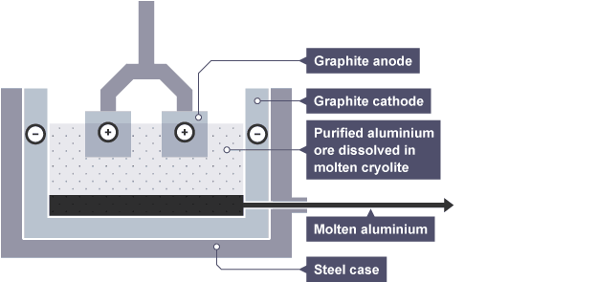
CH-105 INORGANIC TUTORIAL -I
Topic-II
Al by electrolysis
Al₂O₃ and TiO₂ have rather large negative heats of formation. Therefore, their heats of decomposition (i.e., Dissociation Energies) are correspondingly high.
For ΔGº to be negative, it requires that TΔSº term to be very large, which means the temperature must be very high. In effect, these substances are thermally very stable and resist decomposition.
Al₂O₃ ΔH_{f} = -1676 KJ/mol; this energy is sufficient enough to melt the reaction products.
Thermite process
Fe₂O₃ + 2 Al → Al₂O₃ + 2 Fe (liquid)
Al₃+ + 3e– → Al (reduction – gain electrons)
2O₂– → O₂ + 4e– (oxidation – lose electrons)
Ti by Kroll/Van Arkel.
TiCl₄ + 2Mg → Ti + 2MgCl₂

Slide 10
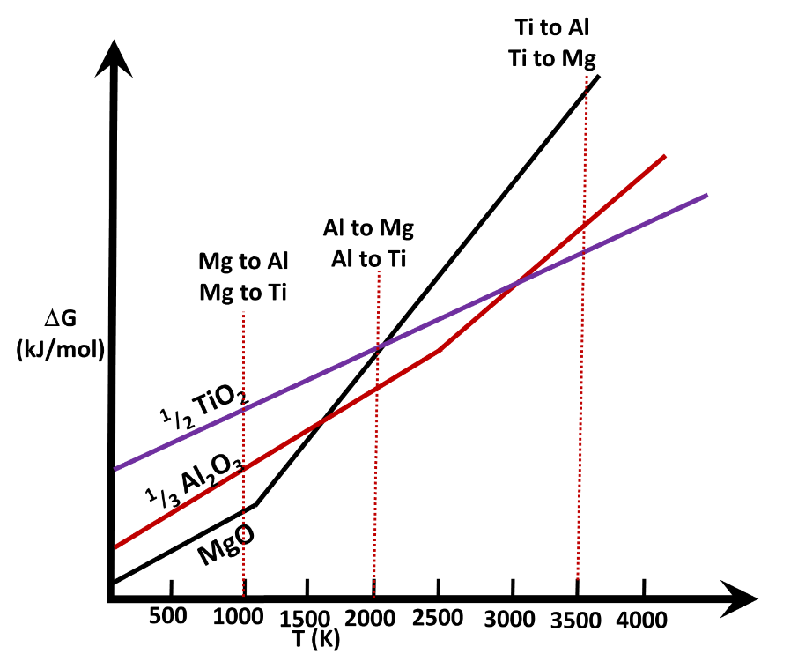
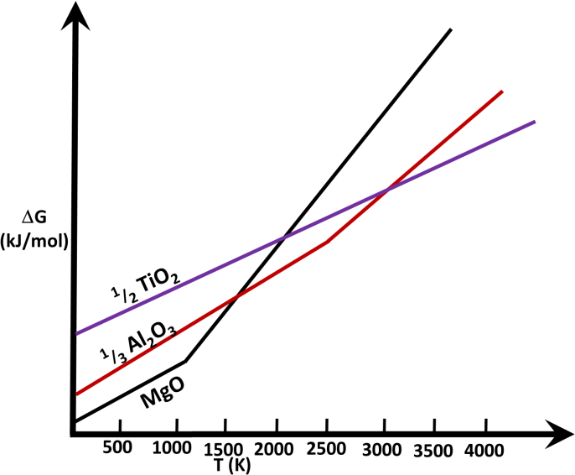
Q-II.2. The Ellingham diagram of metal oxides is given below. Depict how to obtain (a) Mg from MgO using Al and Ti metals (b) Al from Al₂O₃ using Mg and Ti metals (c) Ti from TiO₂ using Mg and Al in the graph given below.
CH-105 INORGANIC TUTORIAL -I
Topic-II

Slide 11
Q-II.3. To a silver nitrate solution, an aluminium rod is initially inserted. After ~20 minutes, a magnesium rod is inserted to the same solution. After another 20 minutes, O₂ is bubbled into the solution at a slightly elevated temperature. What are the products formed at each stage? (You may use the following redox potentials Al³⁺/Al = -1.66 V; Ag⁺/Ag = +0.80 V; Mg²⁺/Mg = -2.36 V; O₂/2O²⁻ = + 1.36 V).
CH-105 INORGANIC TUTORIAL -I
Topic-II

